Slide 1



Task2 冯柏钧

Slide 2
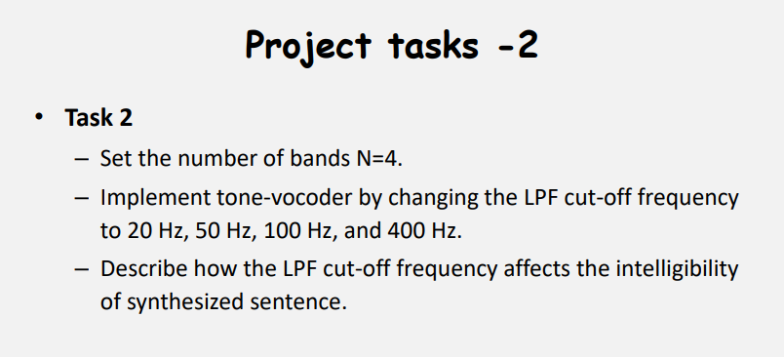

Slide 3
Methodology
Based on multi-band envelope cues, synthesize the speech signal
with the model Tone-vocode.
Filter the original signal with different bandpass filters, do full-wave rectification
and pass a low-pass filer, multiple with a sine wave and finally sum up each components
and get the result.

Slide 4

Audios for the result
cut-off frequency (Hz) Initial file | 20 | 50 | 100 | 400
C_01_01.wav
C_01_02.wav

Slide 5
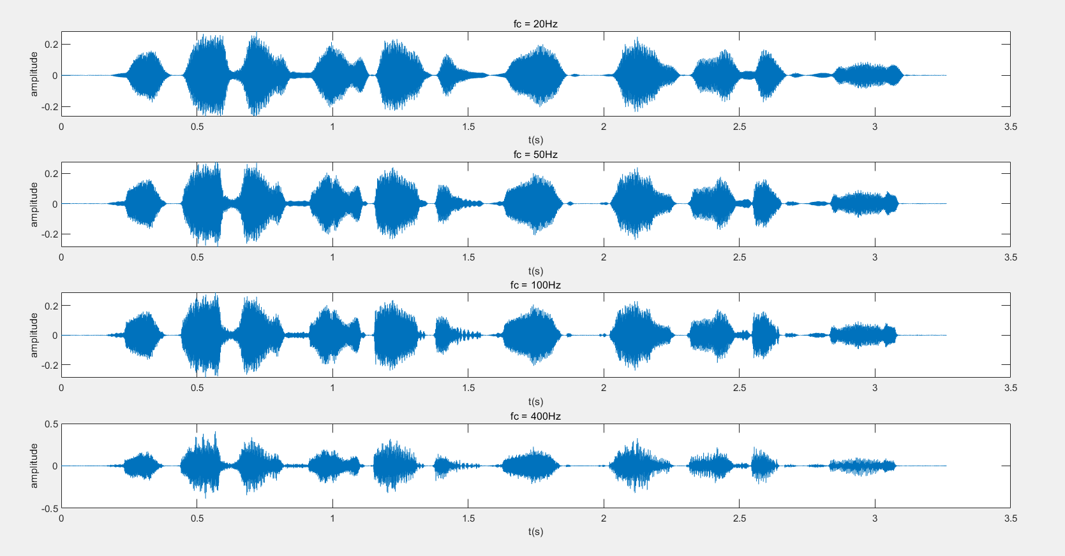
Figures for the result(C_1_01.wav, waveform)

Slide 6
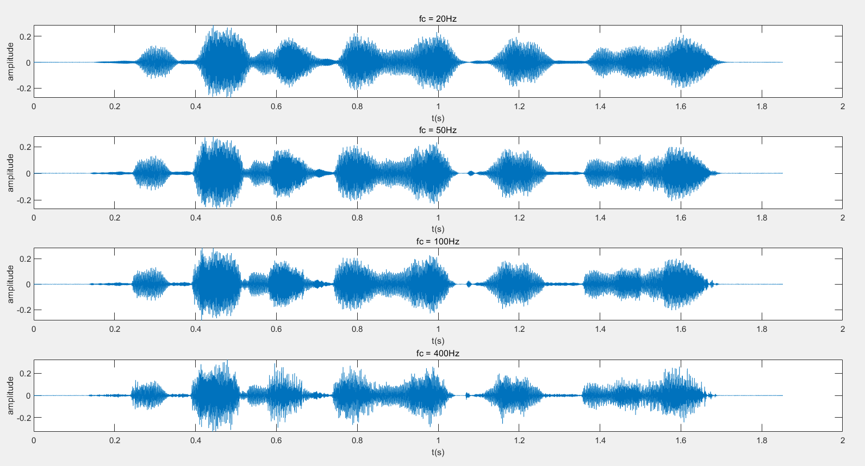
Figures for the result(C_1_02.wav, waveform)

Slide 7
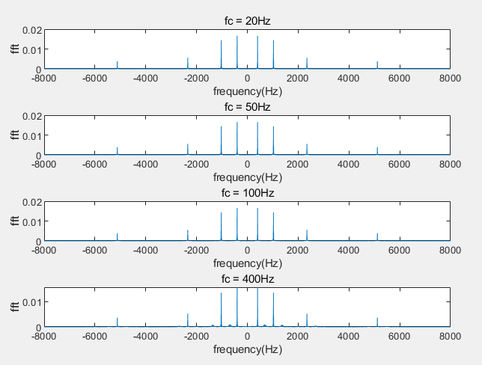
Figures for the result(C_1_01.wav, fft)

Slide 8
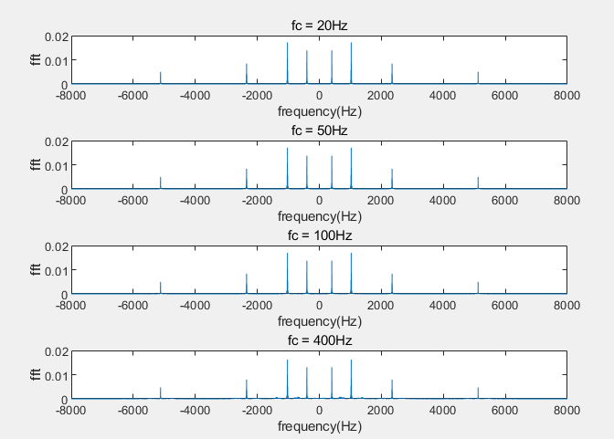
Figures for the result(C_1_02.wav, fft)

Slide 9
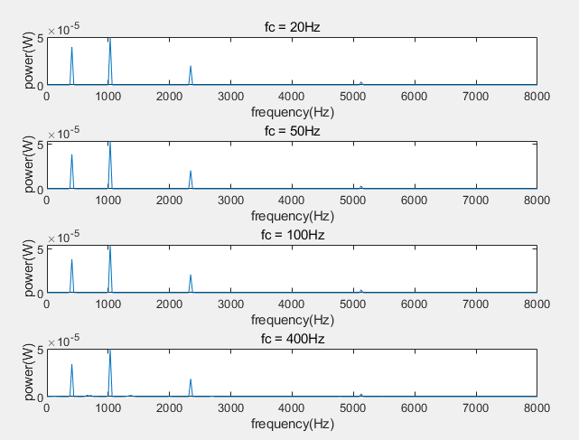
Figures for the result(C_1_01.wav, power)

Slide 10
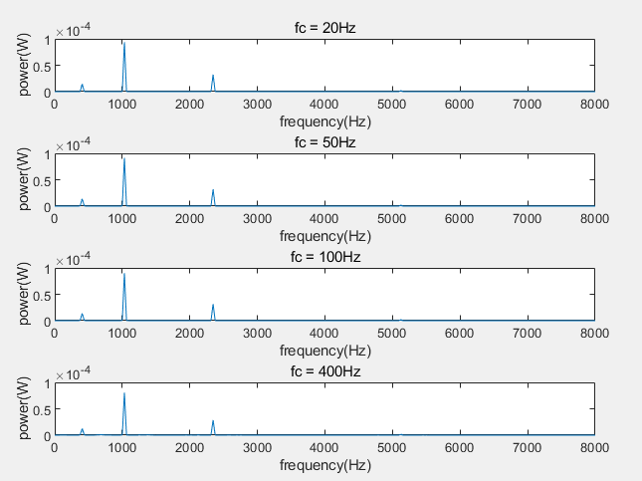
Figures for the result(C_1_02.wav, power)

Slide 11
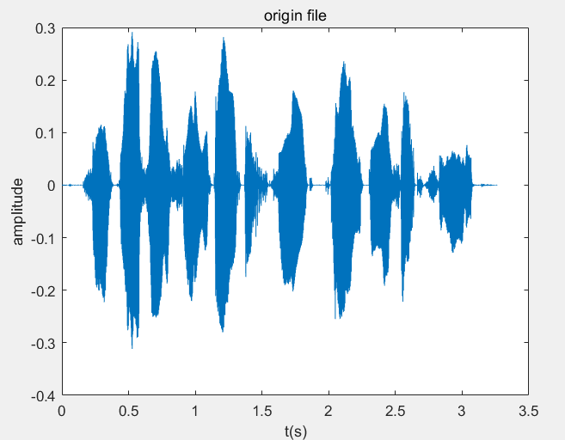
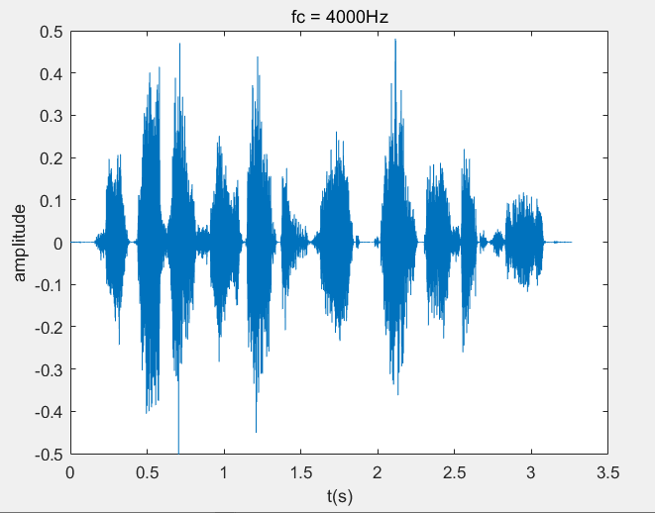
Discussion
Within the given range, as the LPF cut-off frequency increases,
the voice of people becomes clearer.
I design my program with the thinking of functional programming.
Encapsulate my codes to make my work more clear and readable.
I test the LPF cut-off frequency to be 4000Hz, it is clearer than the
previous work, however, there still exists significant difference with
Original file.

